Slide 1
iFarm
IoT Based Automated Farming Robot
Panel “4” Batch “8”
Project Members
Dharmarajan. E (RA1811018010123)
ArunBoniface. A (RA1811018010144)
PraneeshKumar. G. A (RA1811018010143)
Under the Guidance of
Dr. V. Krithika M.E., Ph.D.

Slide 2
Objective
To make the farming robot do the basics activity like Ploughing, Seed dispensing, irrigation and closing the Ploughed field.
Implementation of IoT in this project to control and monitor the work process.
Robots can be controlled by both Autonomously and Manually using Android apps.
Monitor the Humidity and moisture level using sensors.
Charge the battery using Solar Panel

Slide 3
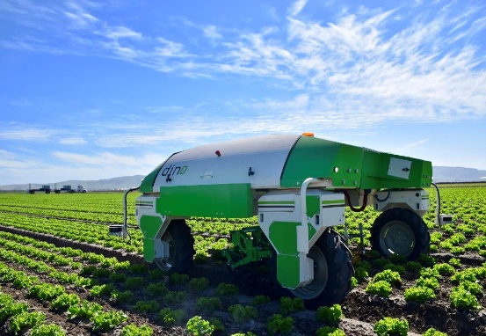
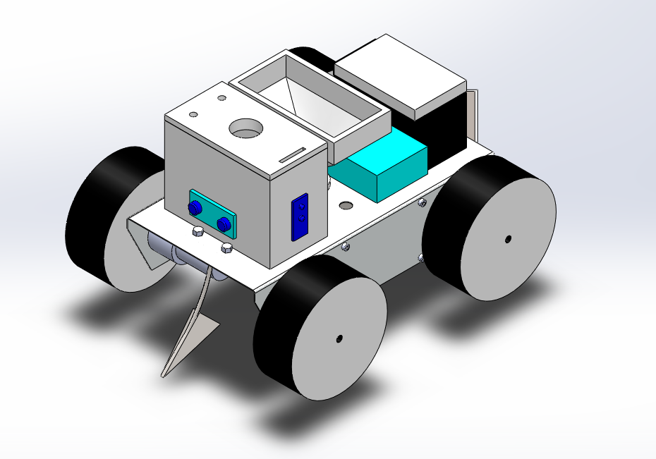
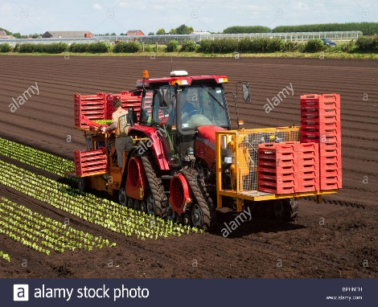
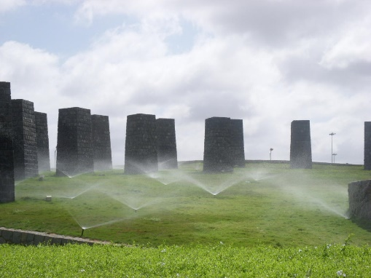
Existing System
Proposed system
Seeding and weeding Robot
Automatic irrigation
Planting
All in one Robot which is capable of performing basic activity like ploughing, irrigating and planting.
This can be monitored using app Implementation of IOT

Slide 4
Initially, seeds are filled in a Funnel and water are filled in a water tank.
While Robot Moving hook at front is used to plough the field and seed closer at the back is used to close plough the field.
From the funnel seeds will be falling one by one after ploughing and water will be pouring drop by drop.
Methodologies

Slide 5
Components required with Price details
S. No | Component Name | Specification | Price /piece (INR) | Quantity required | Total Cost (INR)
1 | Arduino microcontroller | Arduino Mega 2560 | 1000 | 1 | 1000
2 | IoT Board | NodeMCU ESP8266 | 400 | 1 | 400
3 | Chasis | 260X130X60mm | 400 | 1 | 400
4 | Motor Shield | Arduino L293D driver | 350 | 1 | 350
5 | Battery | Lead Acid Battery (12V-1.3A) | 600 | 1 | 600
6 | Sensors | Ultrasonic Sensor | 100 | 1 | 100
7 | Gear Motor | Johnson Motor (12V 500 RPM) | 400 | 2 | 800
8 | Sensors | Water Level Sensor | 100 | 1 | 100
9 | Sensors | Humidity Sensor | 100 | 1 | 100
10 | Sensors | IR sensor | 50 | 2 | 100
11 | Solar Panel | 70x70 | 75 | 4 | 300
12 | Wheels | 100x20 | 75 | 4 | 300
13 | Dummy shaft | 6mm | 25 | 2 | 50
14 | Hook Fabrication | Material and welding | 1500 | 1 | 1500
15 | 3D Printing | Funnel and water tank | 5000 | 1 | 5000
16 | Seed falling mechanism | Material and Welding | 2000 | 1 | 2000

Slide 6
Expected outcome
At the end of the project, we will
Submit the designed and fabricated the robot for farming application.
Create a developed Mobile app and website to control and monitor the temperature and humidity value.

Slide 7
References
S.NO. | Article | Author | Year of Published | Link
1 | Agricultural Automation Robot Using Arduino | Sujata Bhosale, Asha Biradar, Kanchan Meshram , Asst.Prof.Mr.P.R.Patil | March 2018 | http://oaijse.com/VolumeArticles/FullTextPDF/213_32.AGRICULTURAL_AUTO MATION_ROBOT_USING_ARDUINO.pdf
2 | Automatic Multipurpose Agribot Using Arduino Mega | Amol Gothankar , Vishal Soni , Avinash Vishwakarma , Sagar Jankar , Satish Bhoyar | April 2021 | https://ijisrt.com/assets/upload/files/IJISRT21APR684.pdf

Slide 8
Work split up among the members
S.NO | TITLE | Dharma | Arun | Praneesh
1 | Designing | P | S | -
2 | Purchase | P | P | S
3 | Fabrication | P | - | S
4 | Assembly | S | P | S
5 | Wiring | S | P | P
6 | Coding | P | S | P
7 | Testing | P | P | P
8 | Report | - | P | P
P- Primary Responsibility,
S – Secondary Responsibility

Slide 9
Thank You

